Slide 1
Viva Connections & SharePoint Framework Bi-weekly sync
aka.ms/m365pnp
Your host in this call: Garry Trinder (Microsoft)
We ❤ Patrick
September 22nd, 2022
Microsoft 365 PnP Team

Slide 2
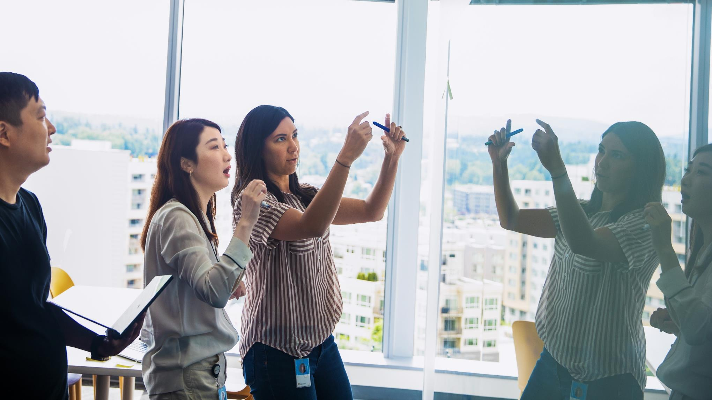



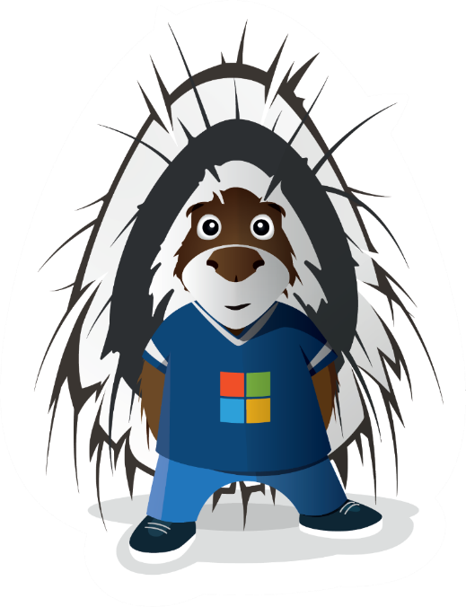
Agenda
Latest update on the SharePoint Framework
Patterns and Practices Updates
PnPjs
CLI for Microsoft 365
Reusable PnP SPFx controls
New Community Samples
Picture time with Together Mode!
Demos
Nanddeep Nachan & Ravi Kulkarni – Viva Connections ACE for Public Holidays
Alex Terentiev – PnP Reusable Controls Basics

Slide 3
Opportunities to Participate in PnP SPFx / JS SIG
SPFx Demo
@pnp Demo
Contribute on GitHub
Provide Feedback
Web Part
Application Customizer
Provisioning
Anything you create!
PnPjs
CLI for Microsoft 365
SPFx Reusable Controls
SPFx Community Yeoman
Report Issues
Submit Pull Requests
Help with issues/questions
How are the calls?
Documentation needs?
Where can we help?
Positive is OK too!
Great opportunity to get visibility for you or your company. Demo sample or explain how you extend or customize SharePoint Online with live demo in your projects. Reach out to team for volunteering.
Request a demo spot on the call
https://aka.ms/m365pnp/request/demo

Slide 4
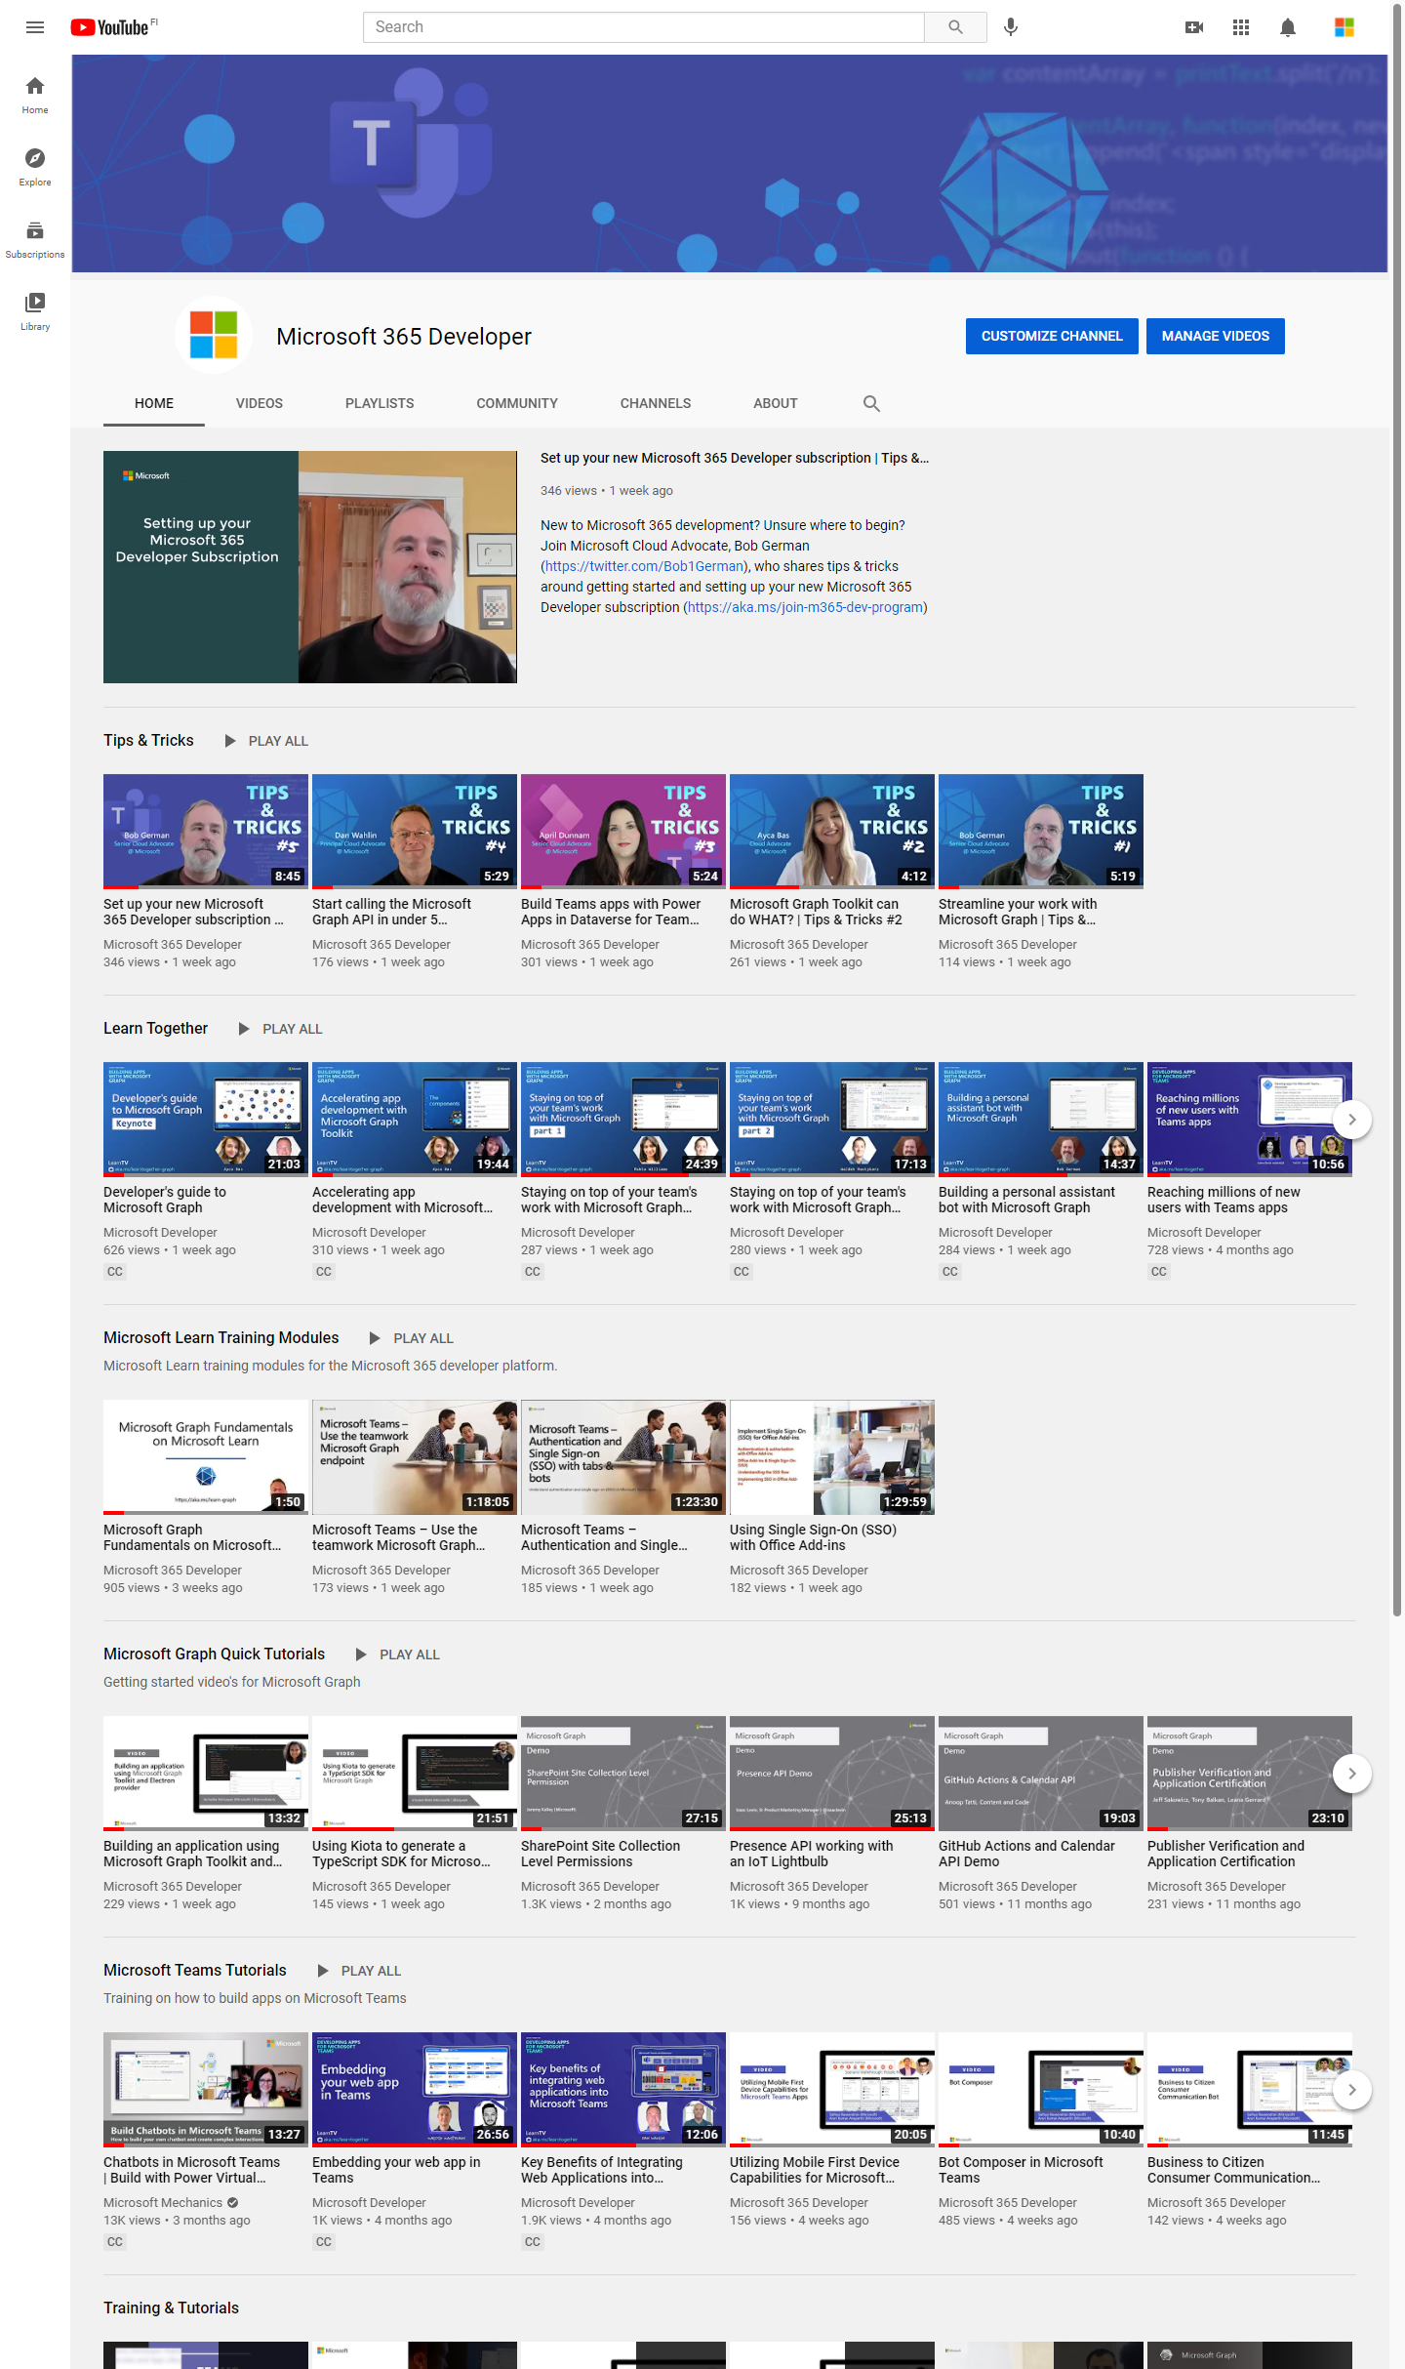
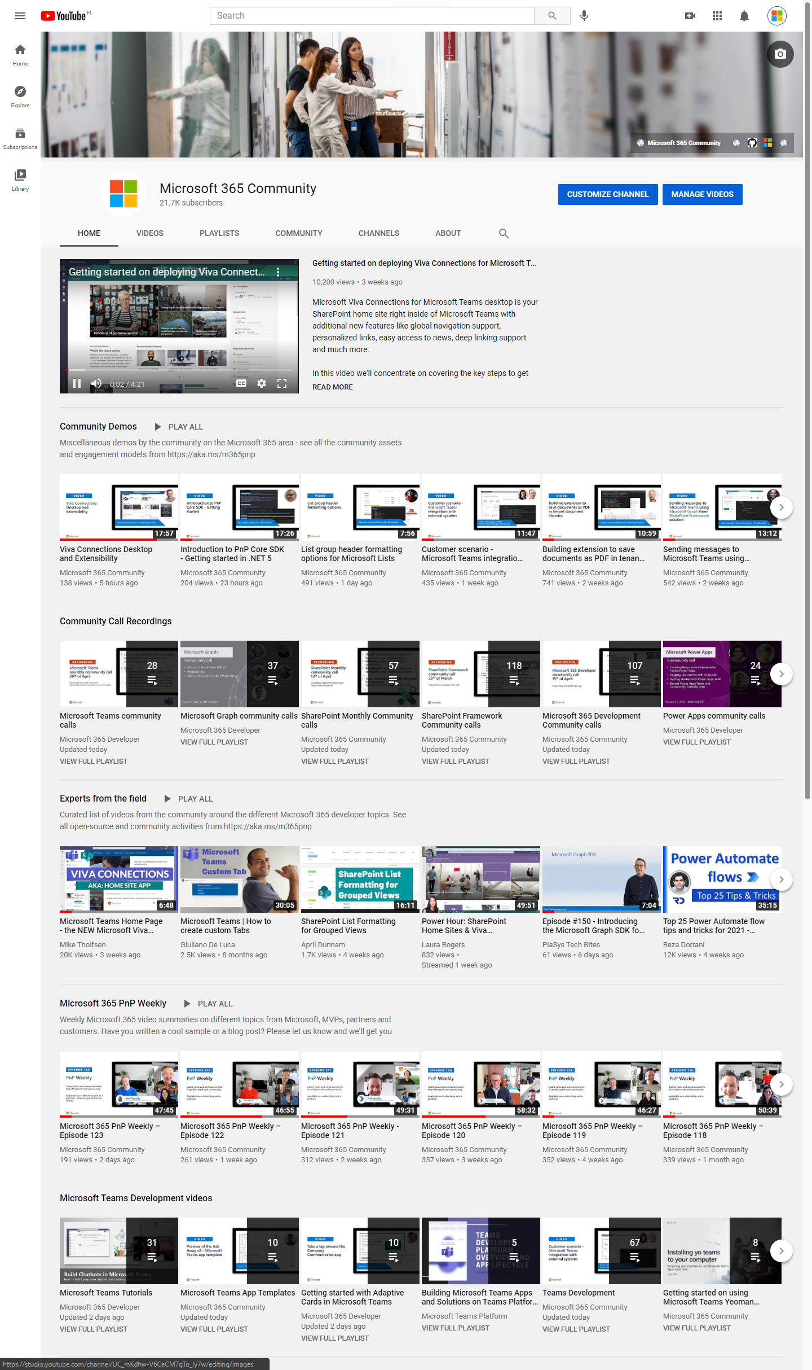
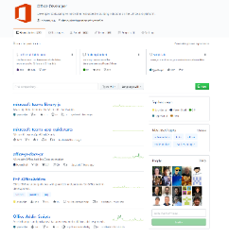
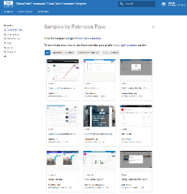
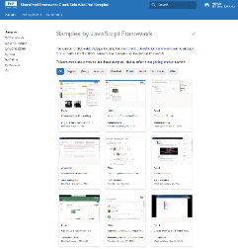
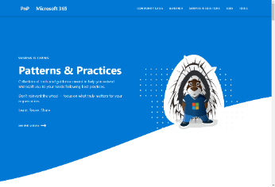
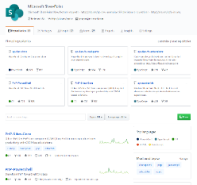
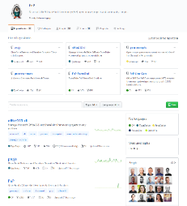
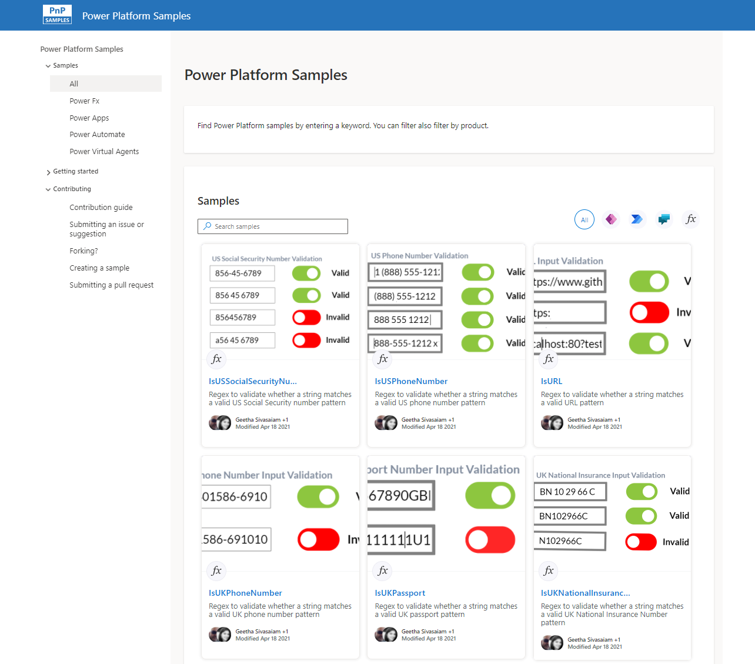
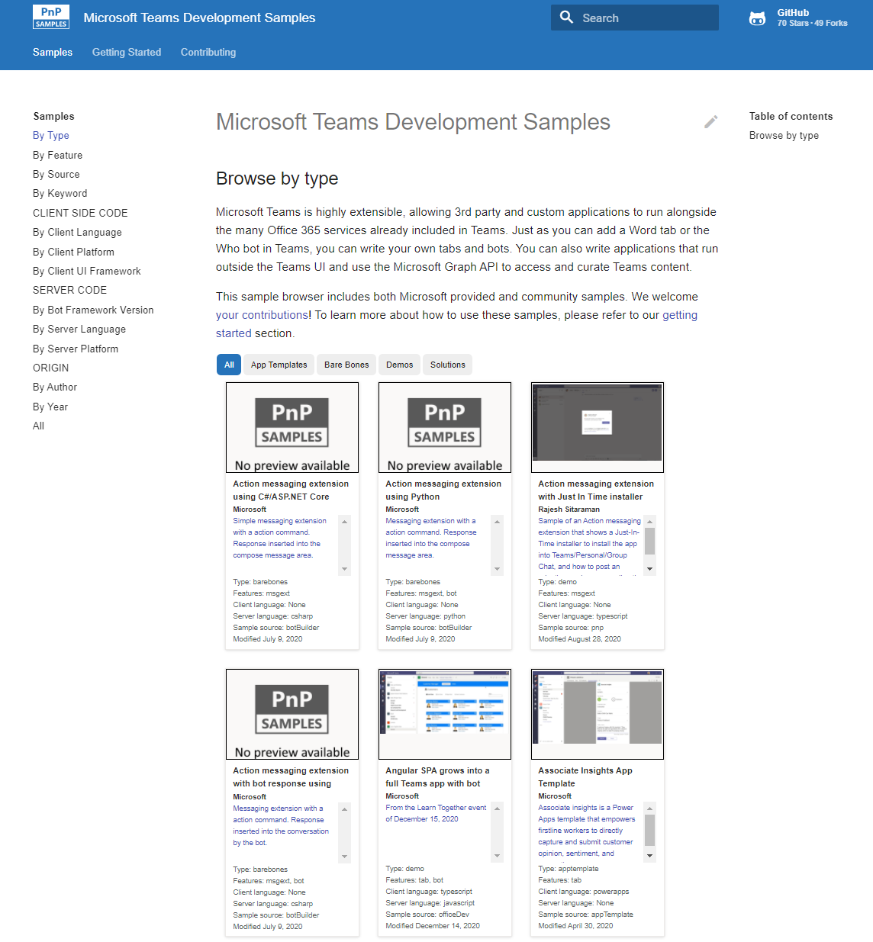
Microsoft 365 developer videos
Microsoft 365 community videos
Open-source
Sample galleries
Open-source initiatives and samples
aka.ms/m365devyoutube
aka.ms/m365/videos
github.com/pnp
github.com/officedev
github.com/microsoftgraph
github.com/sharepoint
github.com/OneDrive
aka.ms/m365/samples
aka.ms/teams-samples
aka.ms/spfx-webparts
aka.ms/spfx-aces
aka.ms/powerplatform-samples
aka.ms/spfx-extensions
aka.ms/list-formatting
aka.ms/m365/community
@Microsoft365Dev | @m365pnp
One URL to rule them all…

Slide 5
Microsoft 365 developer community calls
Microsoft 365 platform (weekly) https://aka.ms/m365-dev-call
Adaptive Cards https://aka.ms/adaptivecardscommunitycall
Microsoft identity platform https://aka.ms/IDDevCommunityCalendar
Office Add-ins https://aka.ms/officeaddinscommunitycall
Power Platform https://aka.ms/PowerPlatformCommunityCall
Microsoft 365 and Power Platform community (bi-weekly) https://aka.ms/m365-dev-sig
Viva Connections & SharePoint Framework (bi-weekly) https://aka.ms/spfx-call
Download recurrent invites from
https://aka.ms/m365/calls
Notes:
m365-dev-sig

Slide 6
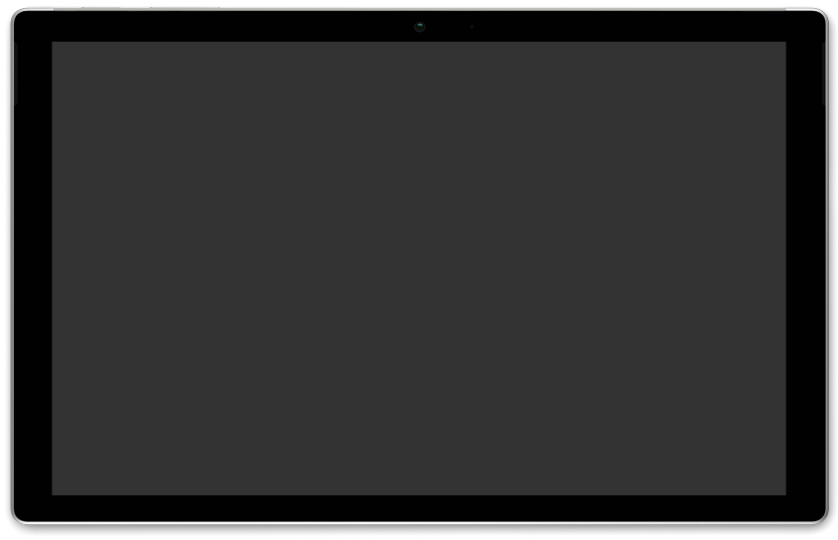
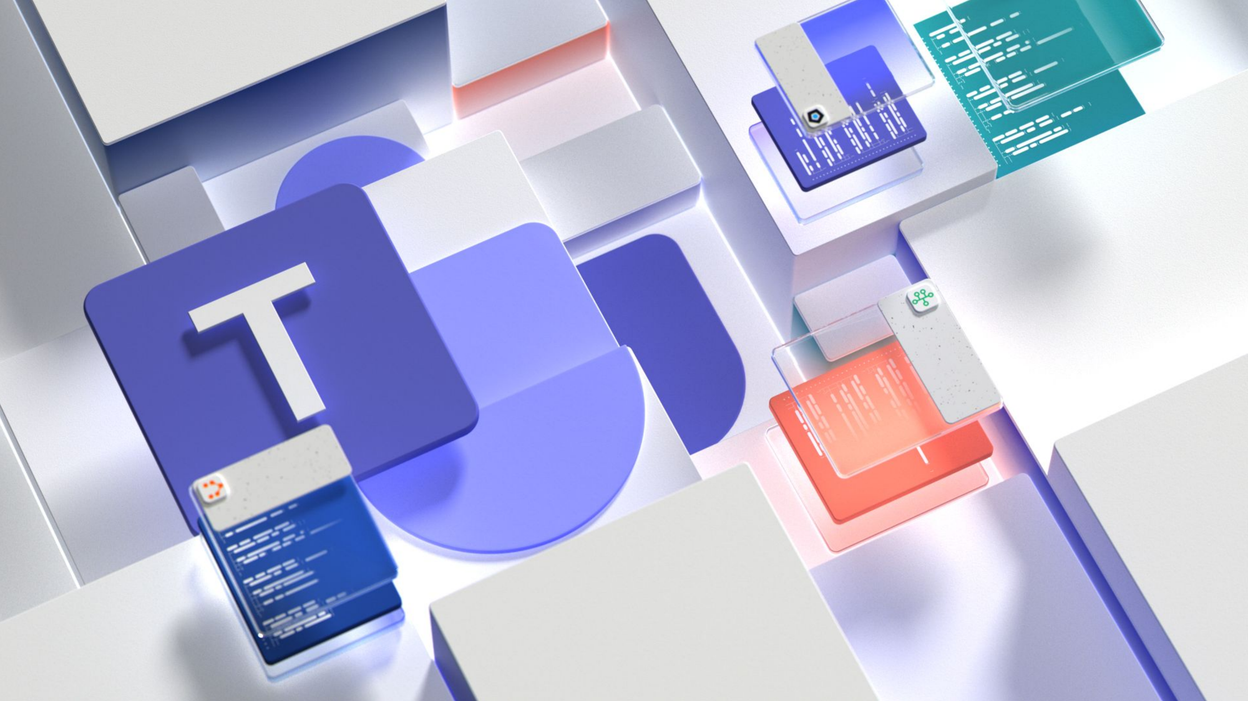

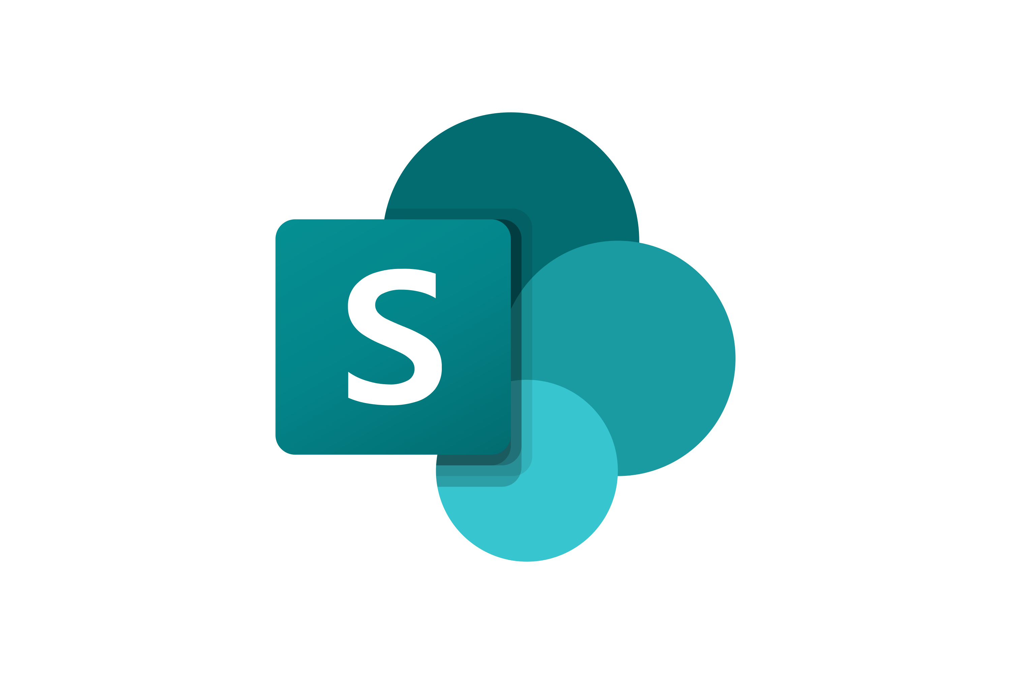



Latest news from Microsoft engineering on Microsoft 365 topics
Monthly community contributors
Community together mode group photo
Ayca Bas - Build a productivity dashboard by using Teams Toolkit for Visual Studio
Vesa Juvonen & Alex Terentiev -SharePoint Framework – Latest status and the next investments areas
AGENDA
Microsoft 365 platform call 27th of September @ 8 AM PT
Weekly call with Microsoft presenters covering the latest Microsoft 365 platform updates
Download recurrent invite from https://aka.ms/m365-dev-call
Notes:
Dan’s slide

Slide 7
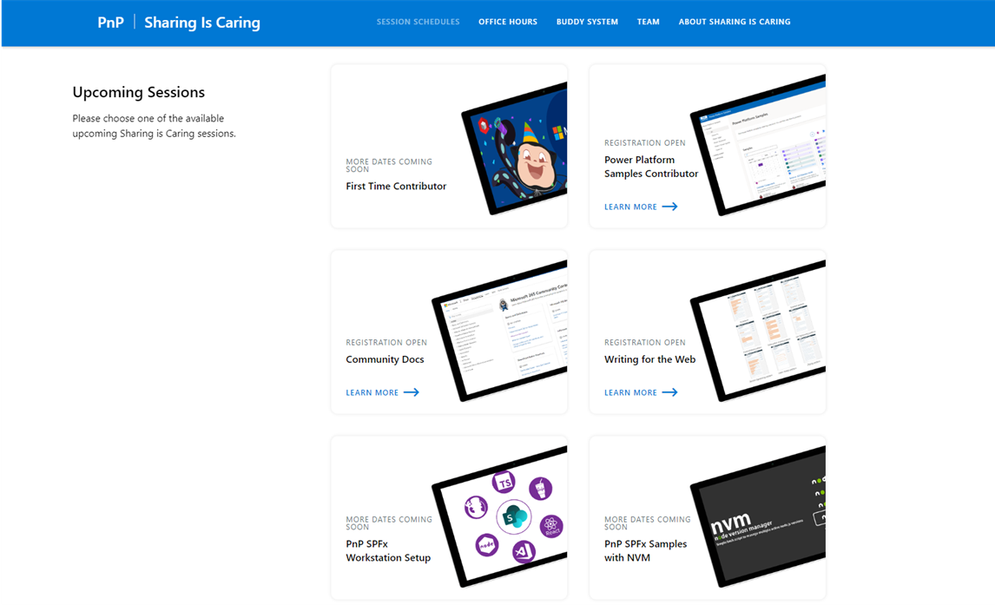
GUIDANCE
Learn how to get started in the open-source PnP community!
Upcoming Sessions:
First-time contributor
Community docs
Using PnP SPFx samples w/ NVM
SPFx developer workstation setup
More than code with VS Code
First-time presenter
M365 Maturity Model Practitioners
Writing for the Web
Power Platform Samples Contributor
New Dates
Scheduling Soon!!
https://aka.ms/sharing-is-caring
Notes:
25 Total attendees, 16 attendees who attended both First-Time Contributors and Community Docs sessions.

Slide 8





COMMUNITY
Recognition Program
Showcase your contributions
Powered by Credly
More achievement levels coming soon
https://aka.ms/m365pnp-recognition
Notes:
25 Total attendees, 16 attendees who attended both First-Time Contributors and Community Docs sessions.

Slide 9
SharePoint Framework Latest from Microsoft engineering for Microsoft Viva, Microsoft Teams and SharePoint extensibility

Slide 10
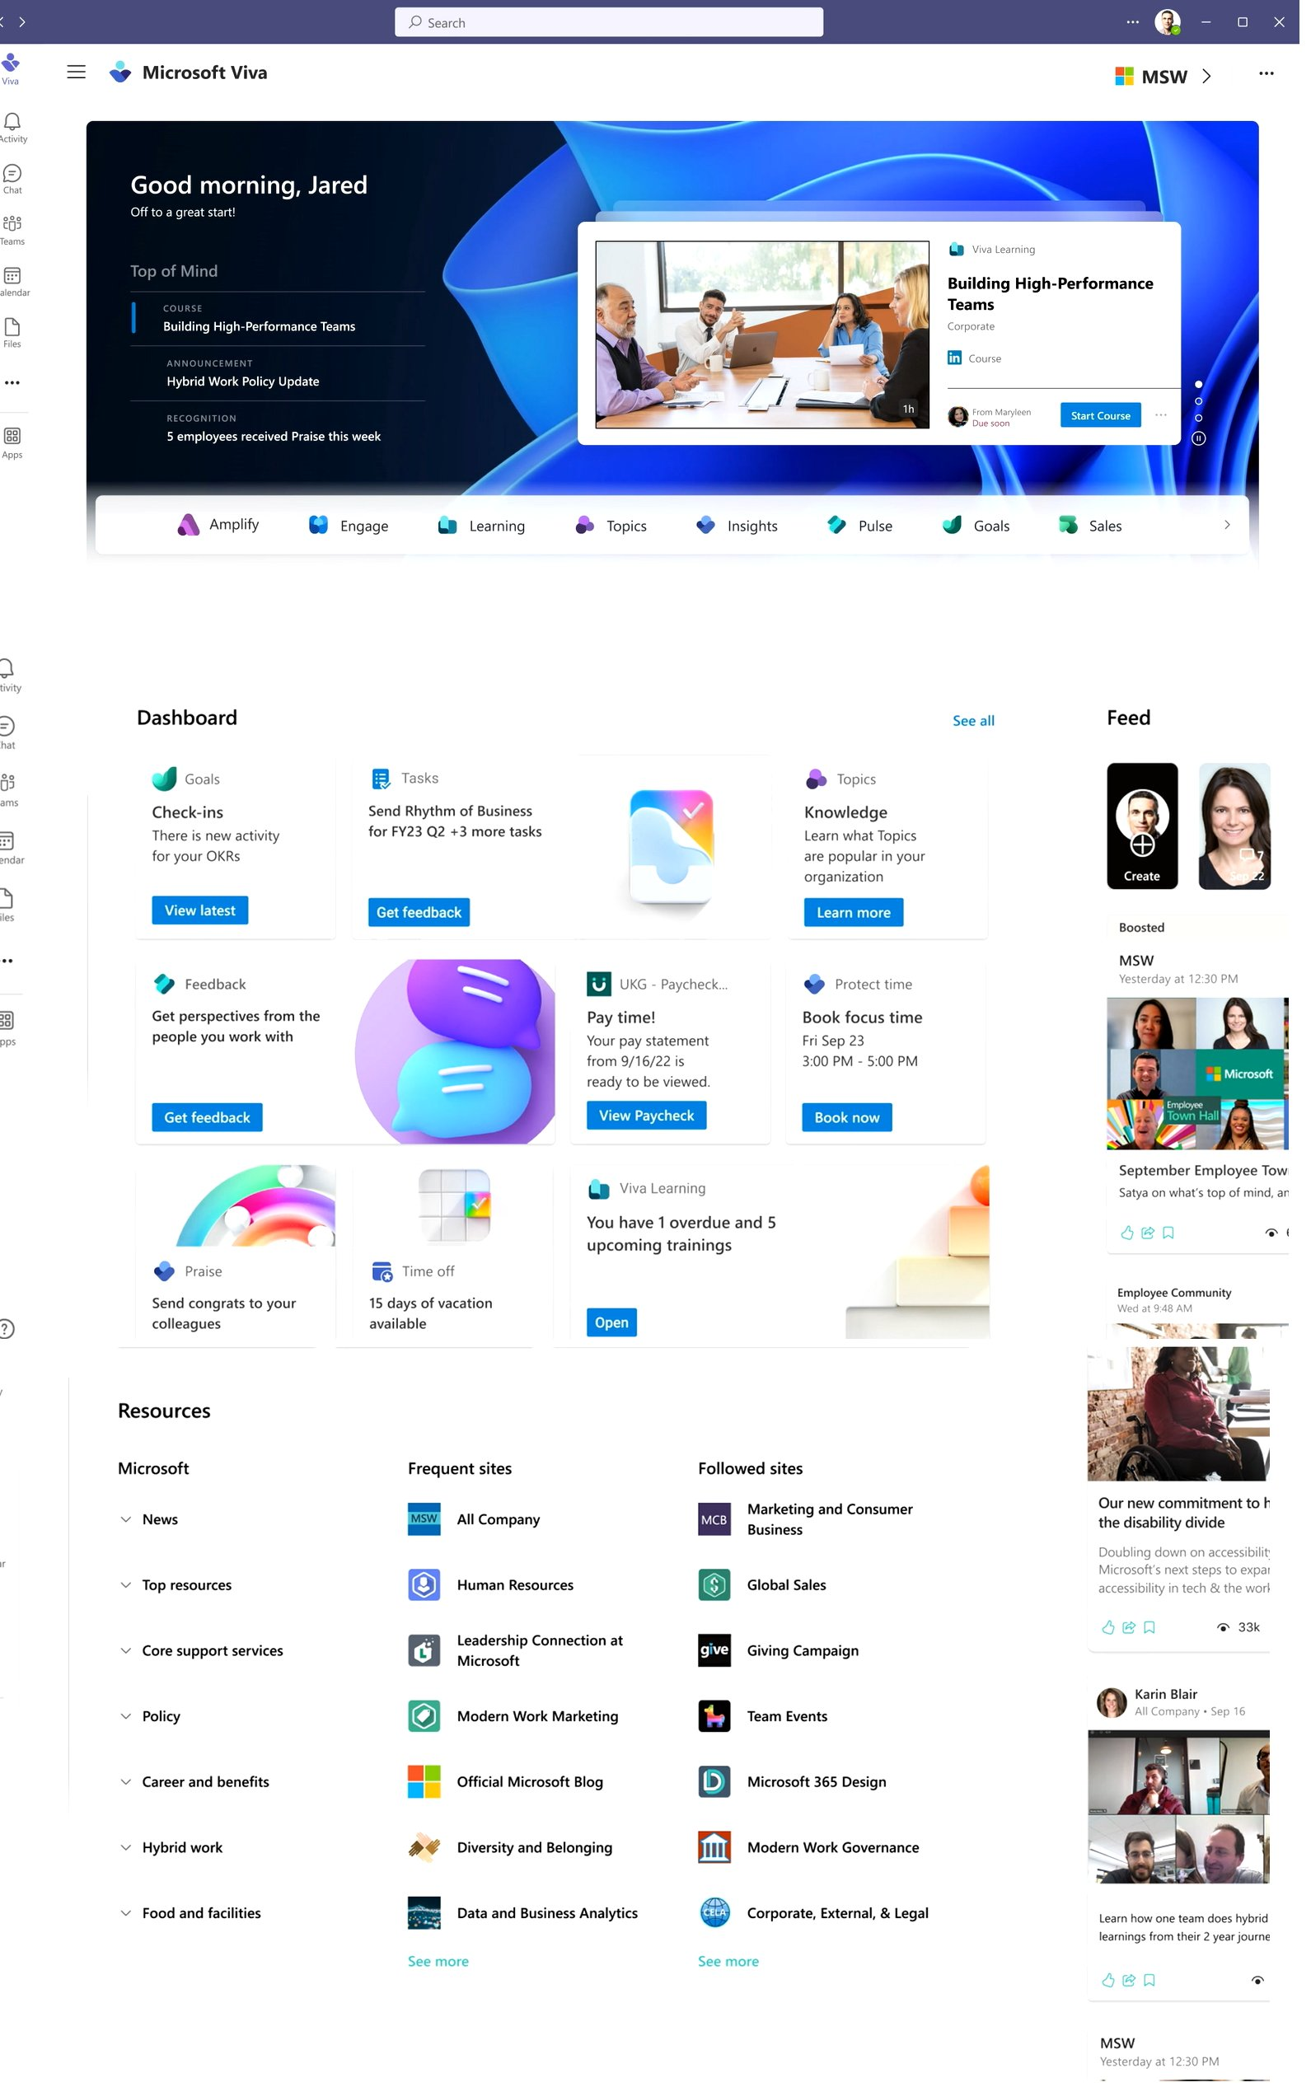
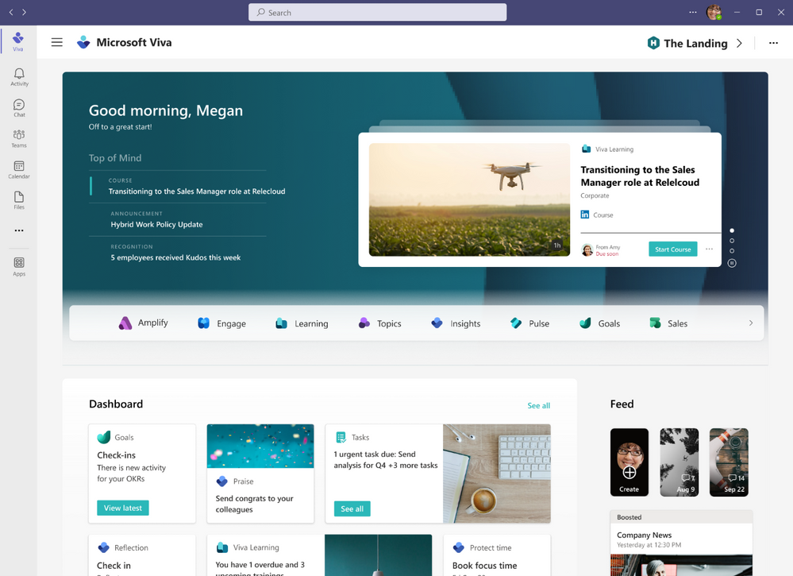
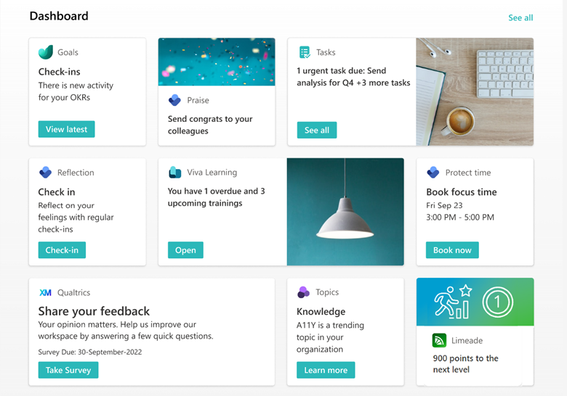
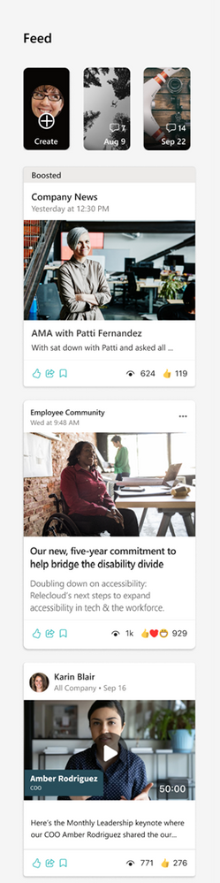
Microsoft Viva Home experience
https://www.microsoft.com/en-us/microsoft-viva/event
Extensibility with SPFx

Slide 11
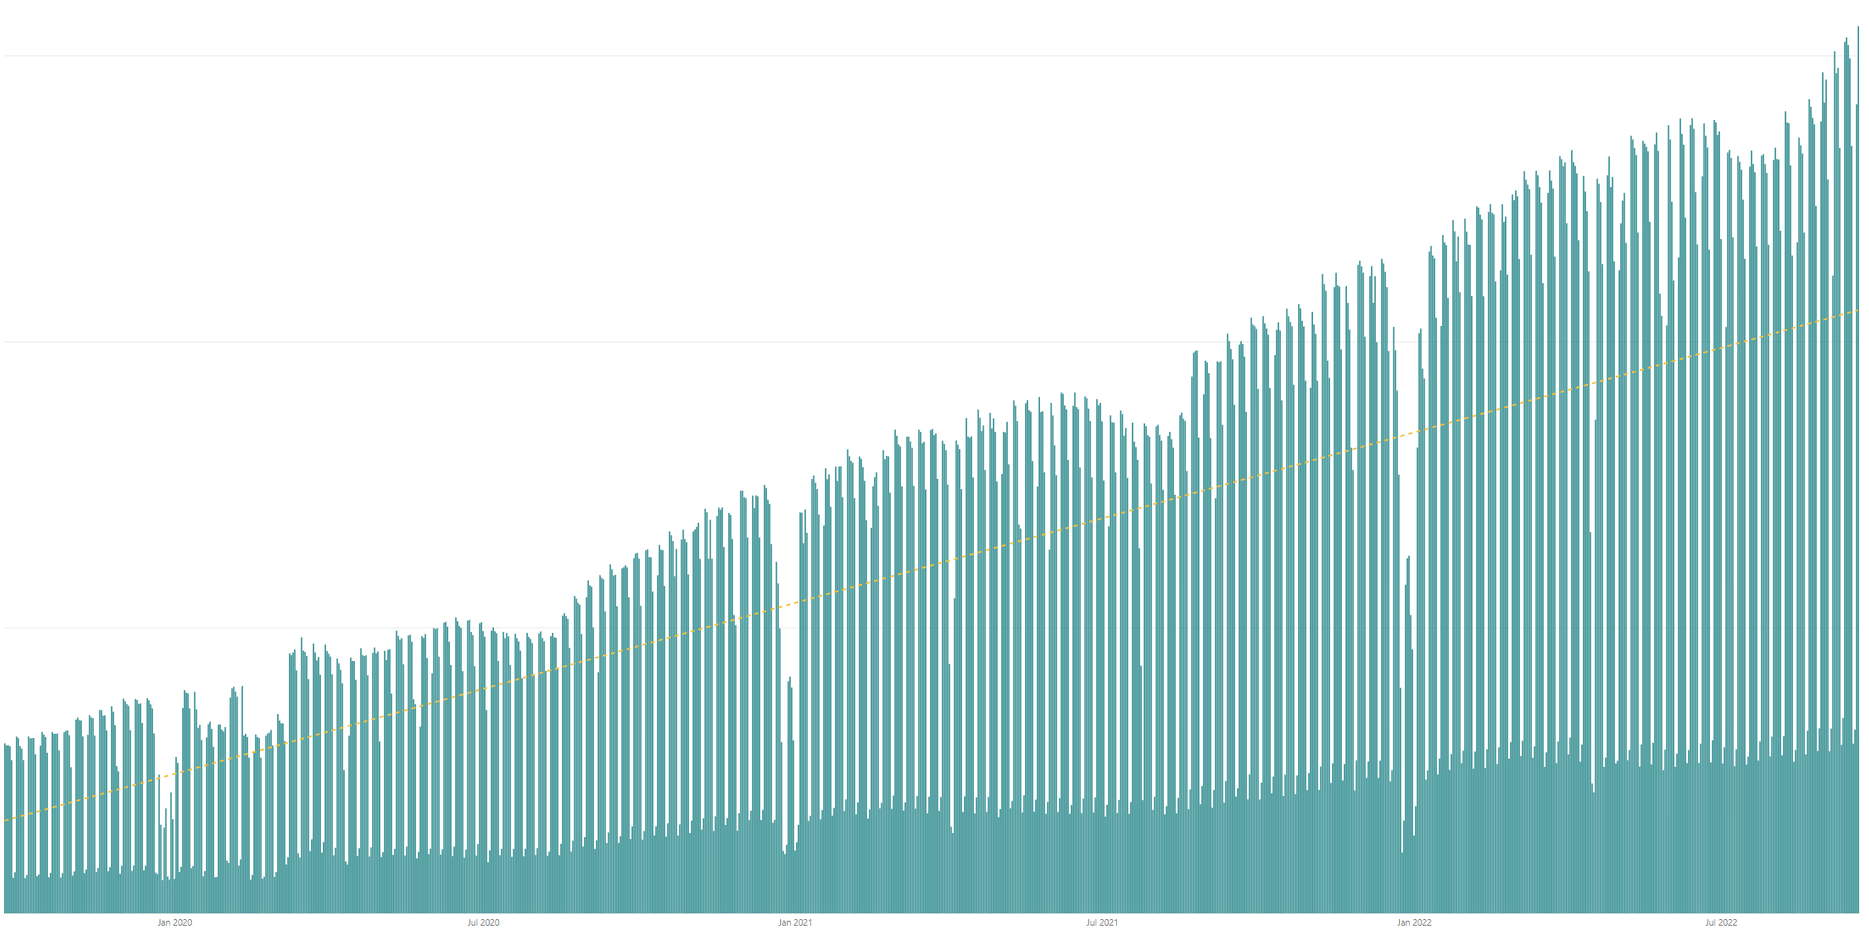

Rolling 28 days active users (MAU) for custom SharePoint Framework components in M365 There are currently tens of millions of monthly active users for customer and partner created SharePoint Framework components in Microsoft 365
All time highest usage in a day – Tuesday 20th of September 2022
Jan 2020
Jul 2020
Jan 2021
Jul 2021
Jan 2022
Jul 2022

Slide 12
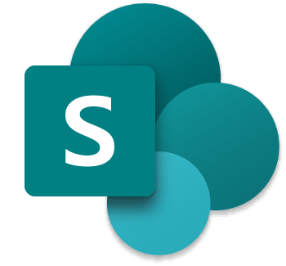



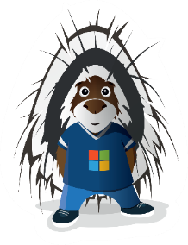
The Road Ahead – SPFx roadmap
1.15.2 – Released in August – latest in prod version
Enable Service Principal Registration in app acquisition flow
New media action type for Viva Connections
ESLint support update based on community feedback
Bug fixes and adjustments based on GitHub issues
1.16 preview released few weeks ago
Teams JavaScript SDK v2 native support in SPFx solutions – rolling out also to existing solution
Asynchronous support for Viva Connections ACEs rendering
New Top Actions support for web parts - Top Actions allow developers to add custom actions to web part's command bar. The feature is like property pane controls but based on cleaner UI approach.
… and more… 🚀
1.16 General Availability in by end of 2022
1.17 ETA in December/January
and more across Microsoft Viva, Microsoft Teams and SharePoint… and more.

Slide 13

PnPjs Client-Side Libraries

Slide 14
























PnPjs Client-Side Libraries
Version 3.7 released Sept 9th
General documentation updates
Support for SP favorites (thank you Konrad K.)
$search & $filter parameters on Graph pages behavior
Ability to rate and item in SP (1-5)
More improvements for query escaping
Enhancements to copyByPath and moveByPath
Added ACS auth behavior recipe
Don’t forget about the nightly builds
npm install @pnp/sp@v3nightly --save
Docs: https://pnp.github.io/pnpjs/ @m365pnpjs on twitter

Slide 15
CLI for Microsoft 365

Slide 16
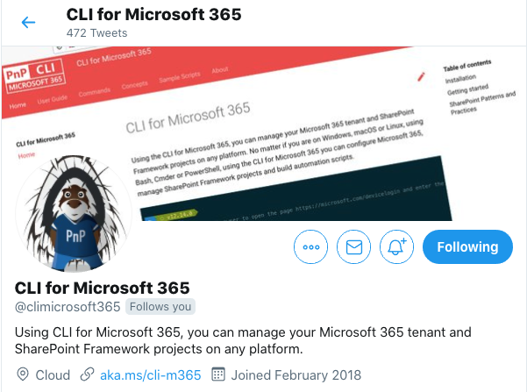
CLI for Microsoft 365
New 5.8 beta with:
Support for executing custom web requests
Support for retrieving a list of OneNote notebooks
Support for retrieving API level changes in Microsoft Graph
Support for managing SharePoint Online web and list item role assignments
Support for creating SharePoint Online role definitions
And more...
Install and run 5.8 beta:
npm install -g @pnp/cli-microsoft365@next
docker run --rm –it m365pnp/cli-microsoft365:next
Release notes:
https://pnp.github.io/cli-microsoft365/about/release-notes/
V6
ETA November ‘22
@climicrosoft365 #CLIMicrosoft365 on Twitter
📖 aka.ms/cli-m365
🗣 github.com/pnp/cli-microsoft365/discussions
Notes:
Introduce yourself - "Hey everyone 👋 "
High level - "We have been busy adding new capabilities to CLI for Microsoft 365 v5.8 beta which we will release at the end of the month"
Summary - "In this release we have new commands and enhancements across Microsoft Graph, OneNote, SharePoint Online, as well as general improvements and bug fixes. Most notably we have added a new command that will help you execute web requests using the CLI"
CTA (engage) - "I have provided some links in the chat for you to access all the key resources surrounding this release"
CTA (check docs) - "please checkout the release notes for further detail on what has been included so far"
CTA (install) - "If you want to try out the beta version, you can install directly from npm, or alternatively use our Docker image to run CLI in a container"
CTA (follow us) - "If you want to keep up with the latest beta releases, I recommend that you can follow our Twitter account @climicrosoft365"
CTA (feedback) - "If you have any feedback (both positive and negative) or ideas for new features that you'd like to see, then please checkout the GitHub repo, and either raise an issue or start a discussion, we would absolutely love to hear from you"
Closing (Thank you) - "Finally, thank you to all the contributors who made this release possible. That’s all for now, thank you”
📝 Release notes - CLI for Microsoft 365 (pnp.github.io)
⚡️ request - CLI for Microsoft 365 (pnp.github.io)
📦 @pnp/cli-microsoft365 - npm (npmjs.com)
🐳 Run CLI in a Docker Container - CLI for Microsoft 365 (pnp.github.io)
💬 CLI for Microsoft 365 (@climicrosoft365) / Twitter
💻 pnp/cli-microsoft365: Manage Microsoft 365 and SharePoint Framework projects on any platform (github.com)

Slide 17
SPFx Reusable Components

Slide 18
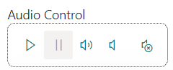
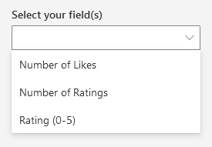
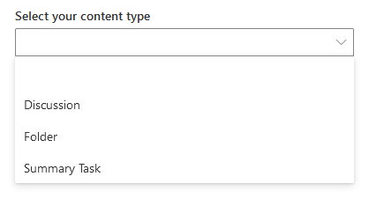
Reusable SPFx Controls
React Controls – 3.10.0
SPFx 1.15.2 support
ability to override field rendering for individual fields in Dynamic Form
Various fixes
Release notes: https://pnp.github.io/sp-dev-fx-controls-react/about/release-notes/
React Property Controls – 3.9.0
SPFx 1.15.2 support
Release notes: https://pnp.github.io/sp-dev-fx-property-controls/about/release-notes/
Special thanks to our contributors: Bart-Jan Dekker, Edin Kapic, Milan Holemans, Steve Beaugé.
More information:
https://sharepoint.github.io/sp-dev-fx-property-controls https://sharepoint.github.io/sp-dev-fx-controls-react
Twitter: @M365PnPControls

Slide 19
PnP Modern Search

Slide 20
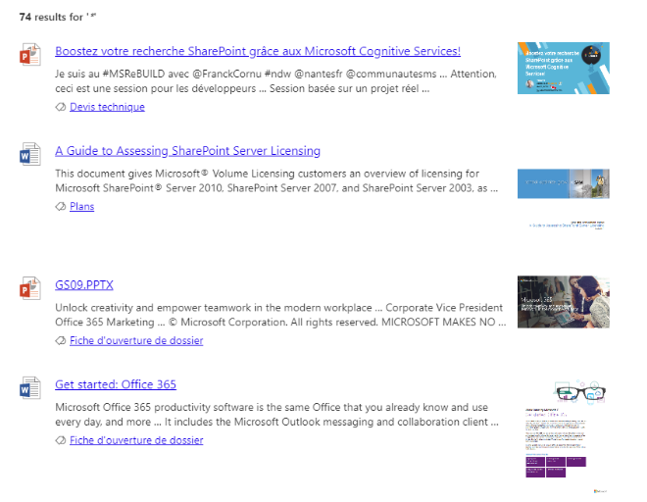
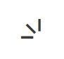
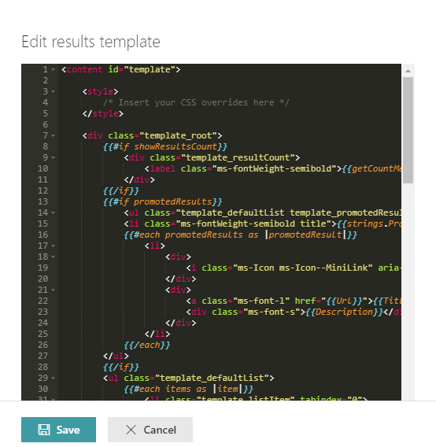
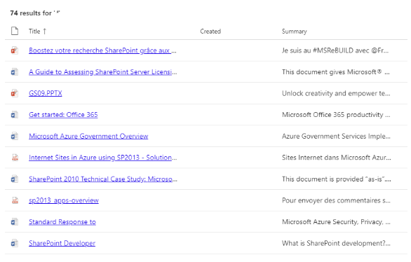

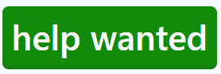
PnP Modern Search
http://aka.ms/pnp-search
Building modern Search experiences with flexible web parts
v4.8.0-beta – September 2022 release
https://github.com/microsoft-search/pnp-modern-search/releases
Thank you @emilyk0520, @davemehr, @PaoloPia for your support
Support for actionable Adaptive Cards (like in Viva)
See release notes for fixes and new features
v3.23.0 – December 2021 release
https://github.com/microsoft-search/pnp-modern-search/releases
See release notes for fixes and new features
Notes:
https://github.com/microsoft-search/pnp-modern-search

Slide 21

PnP SPFx Samples

Slide 22
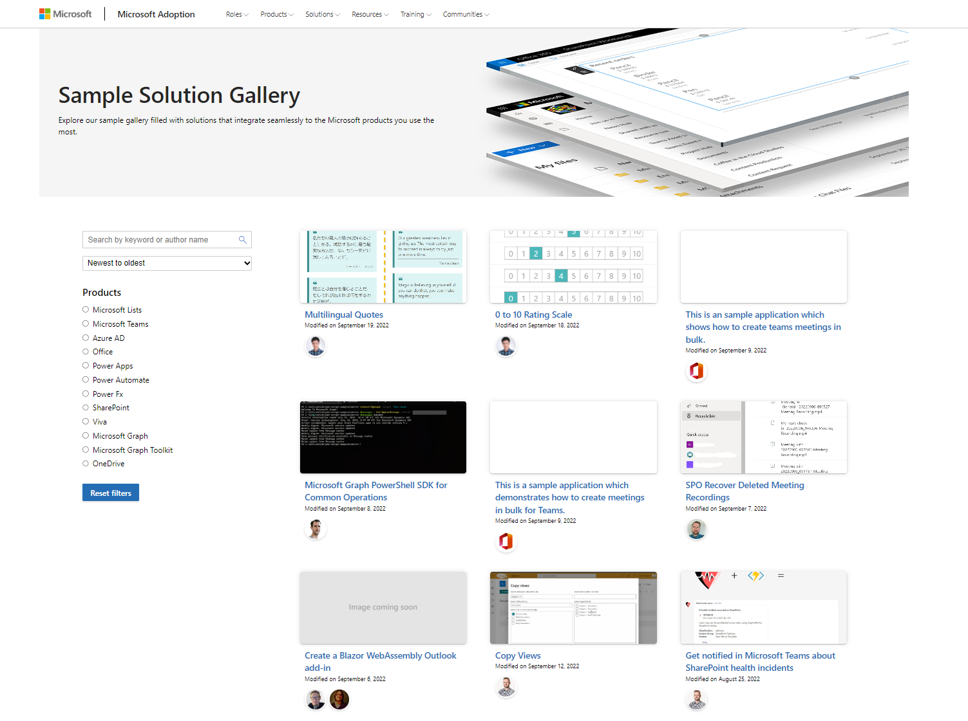
PnP SPFx Samples
PnP SPFx Samples
PnP SPFx Samples
THANK YOU ALL FOR SHARING
https://aka.ms/spfx-extensions
https://aka.ms/spfx-webparts
https://aka.ms/spfx-aces
*** We Love New Samples ***
See all samples from https://aka.ms/m365/samples
Notes:
This is a sample how we can reuse graph client between ACEs from a different solutions. This can be quite handy especially if we implement batching strategy (as in this sample). Thanks to that requests from all ACEs can be batched together, which improves performance and overall end user experience

Slide 23

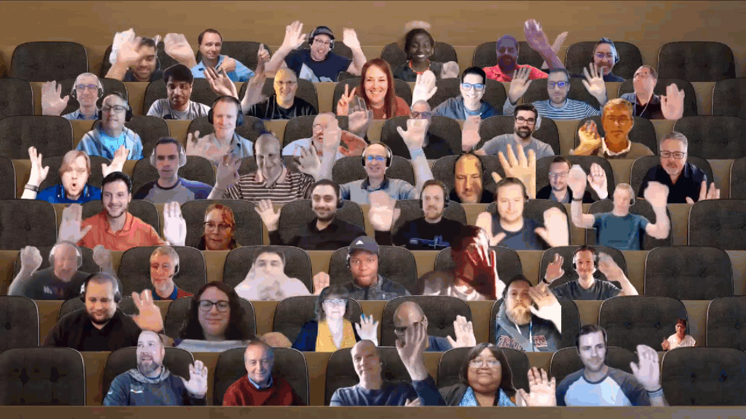

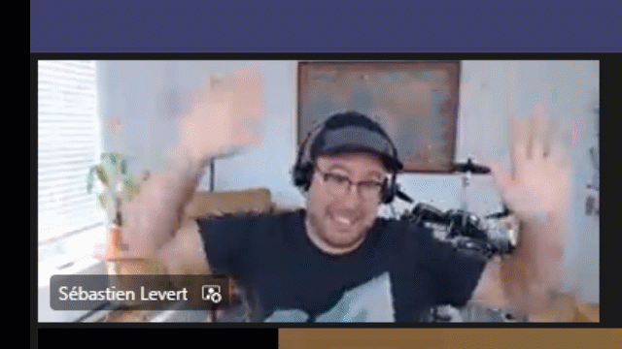
Optional picture time!
Video on and we’ll grab a Together Mode pic with those who are willing to do this.
We are together on this as a community!
Let’s all be like Seb?
By enabling your camera for the picture, you grant us permission to share your picture in social media.

Slide 24

DEMO
Viva Connections ACE for Public Holidays – Nanddeep Nachan – Ravi Kulkarni
PnP Reusable Controls Basics – Alex Terentiev

Slide 25
Thank you!

Slide 26
Thank you
Recording will be available in 24 hours on
Microsoft 365 Community (PnP) YouTube channel
https://aka.ms/m365/videos
(subscribe today)
Follow us on Twitter
@Microsoft365Dev | @M365PnP
Next Viva Connections & SPFx call: October 6th at 07:00am PT
Next M365 General Dev call: September 29th at 07:00am PT
All available community calls from https://aka.ms/m365/calls

Slide 27


aka.ms/m365pnp

